Slide 1



Fetch.AI
INSURIFYAI
Improving Decision-Making in Claims, Transactions, and More
Presented By Group 3

Slide 2




Group 3
Problem Statement
Develop an AI agent to streamline scheme pricing for a UK insurance provider by interpreting diverse document formats and mapping data accurately.
Back to Agenda

Slide 3


Understanding Pension Risks
Investment Risk: Risk of underperformance of fund assets.
Longevity Risk: Risk of retirees living longer than expected.
Inflation Risk: Risk of erosion in the real value of pension benefits.
Group 3

Slide 4







Scheme Beneficiaries Types
Pensioners
Deferred Members
Widow(er)s
Dependants
Active Members

Slide 5








AGENT’S FLOW
EXTRACTION
AGENT:
RULES GENERATOR AGENT :
RECOMMENDATIONS AGENT :
This agent reads and understands important information from uploaded documents, like employee pension details, using advanced AI techniques.
This agent creates customized rules based on the extracted document data. These rules help calculate specific insurance premiums tailored to each employee's needs.
Using the rules generated by the Rules Generator Agent, this agent suggests the best insurance options for employees based on their individual data and calculated premiums.

Slide 6

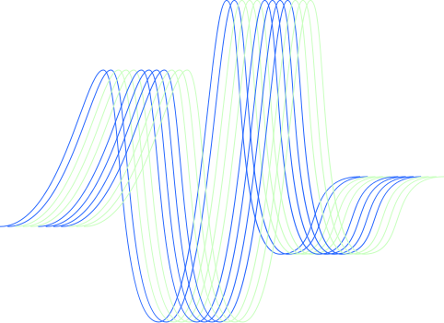



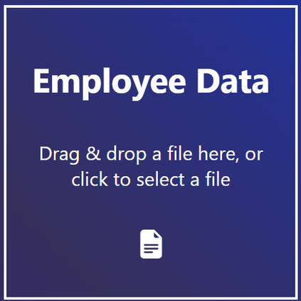
Inputs
Magic
Total cost of pension the employer pays for lifetime and annually.
COMPANY

Slide 7

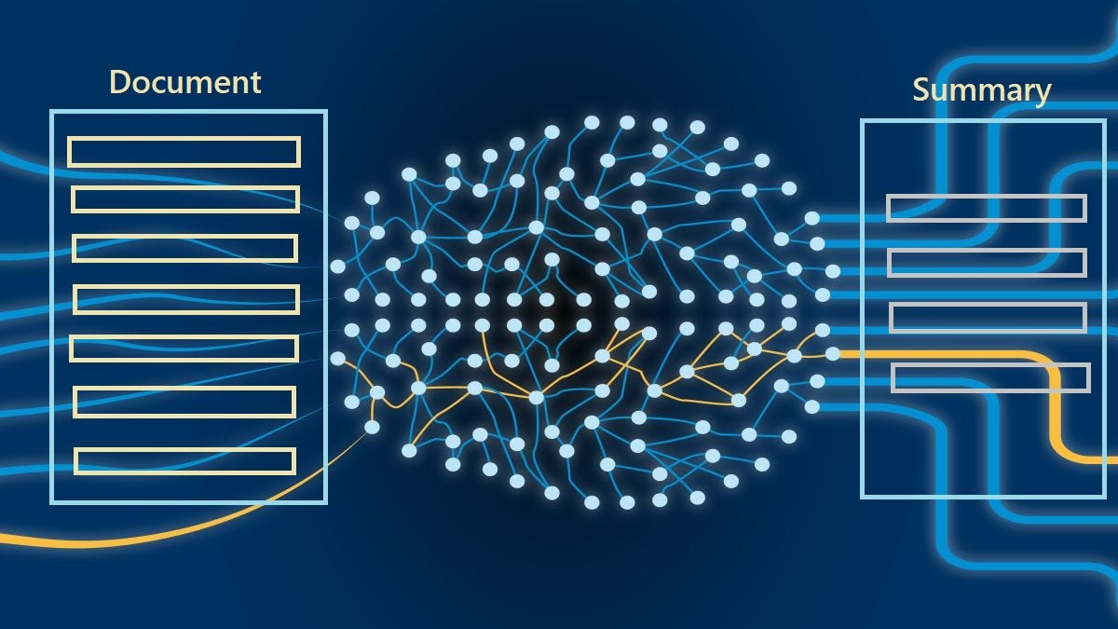
EXTRACTION AGENT

Slide 8





Rules Generator AgenT :
Calculates insurance premium tailored
to employee’s requirments.
AGENT
Extracting
RULES
Examples:
People that smokes gets discount
Differently-abled people gets discount.
Document

Slide 9





Recommendations Agent :
Calculate Cost of Pension
Calculate Premium
Calculate the amount each person would cost them
AGENT
RISK PERCENTAGE
Chances of person passing away == Profit for the company
CHANGES
Smokes
Married
EMPLOYER
Disabled

Slide 10
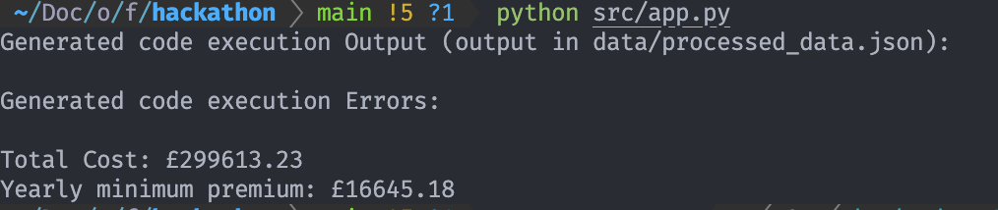
INSURIFYAI
OUTPUT
Back to Agenda

Slide 11
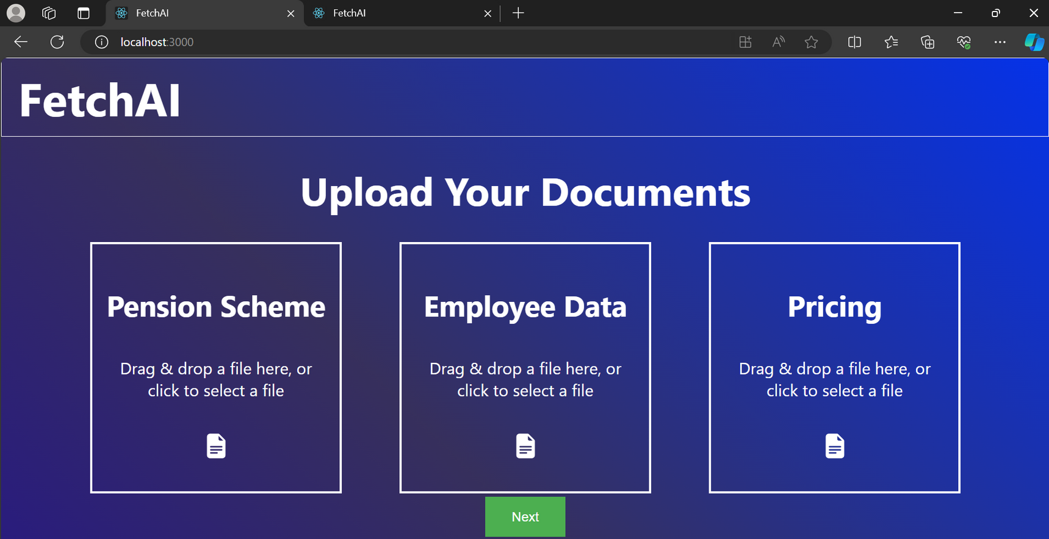
INSURIFYAI
FRONT-END/ INPUT
Users can upload documents and view personalized insurance recommendations with a modern, dynamic interface.
Back to Agenda

Slide 12
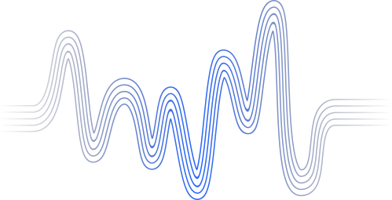




Future Enhancements

